Slide 1
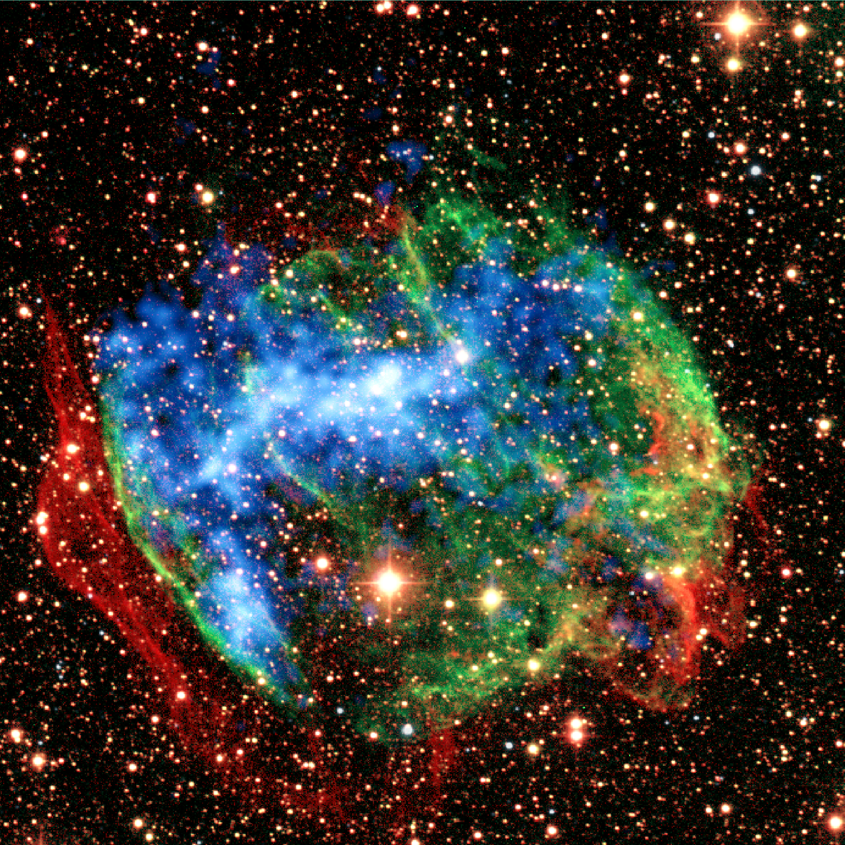
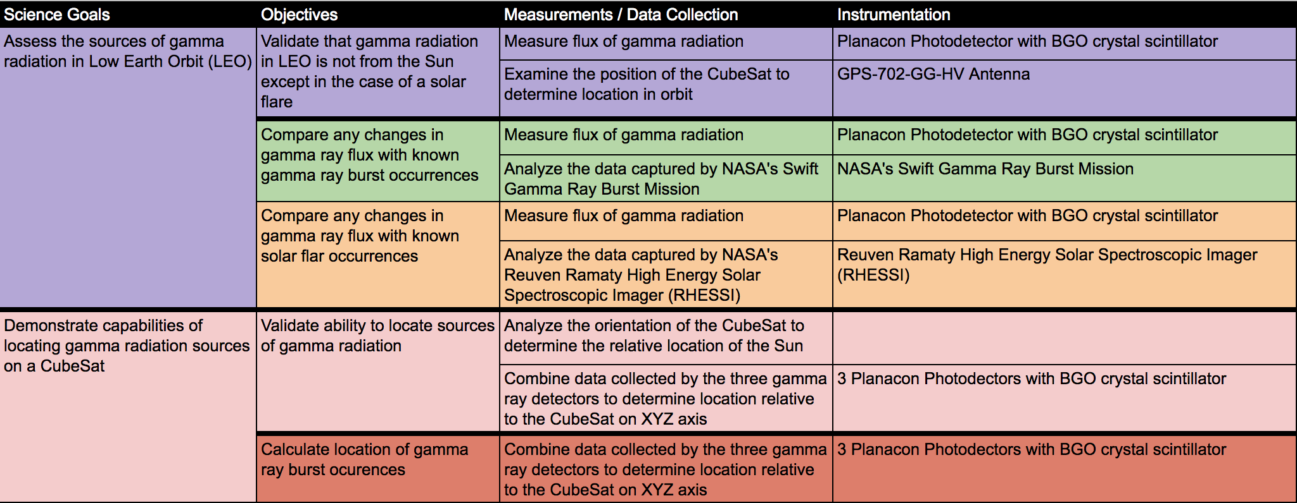
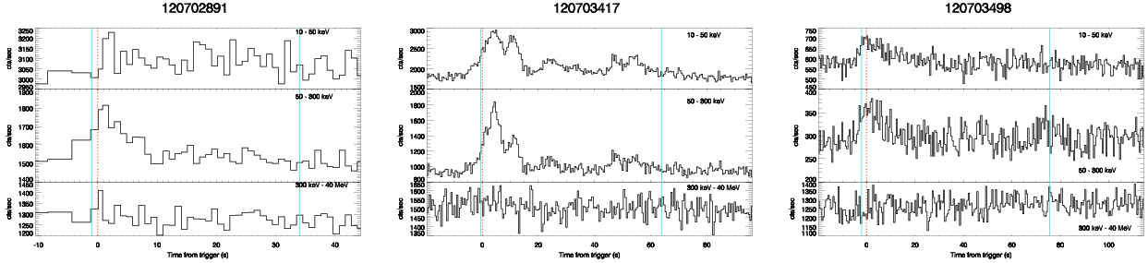
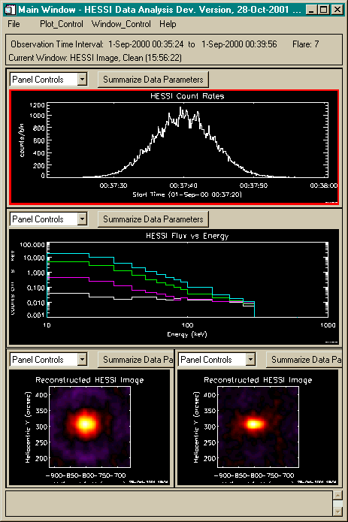
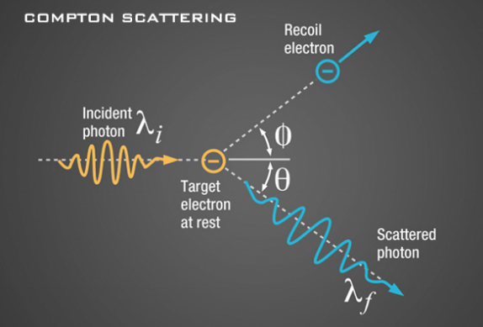
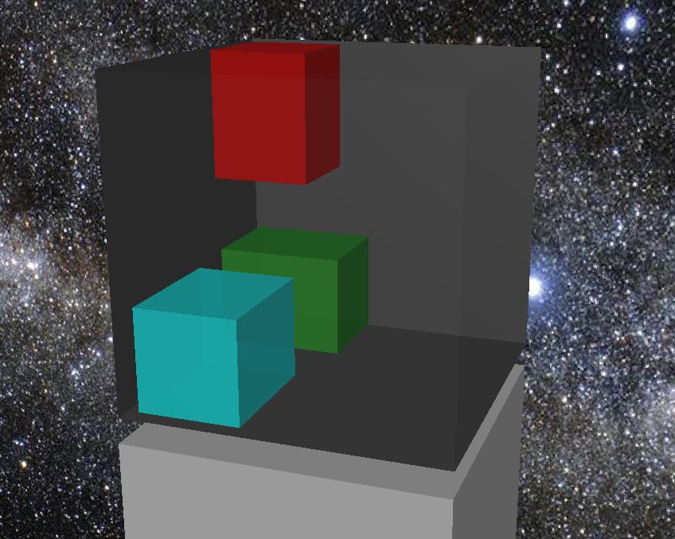
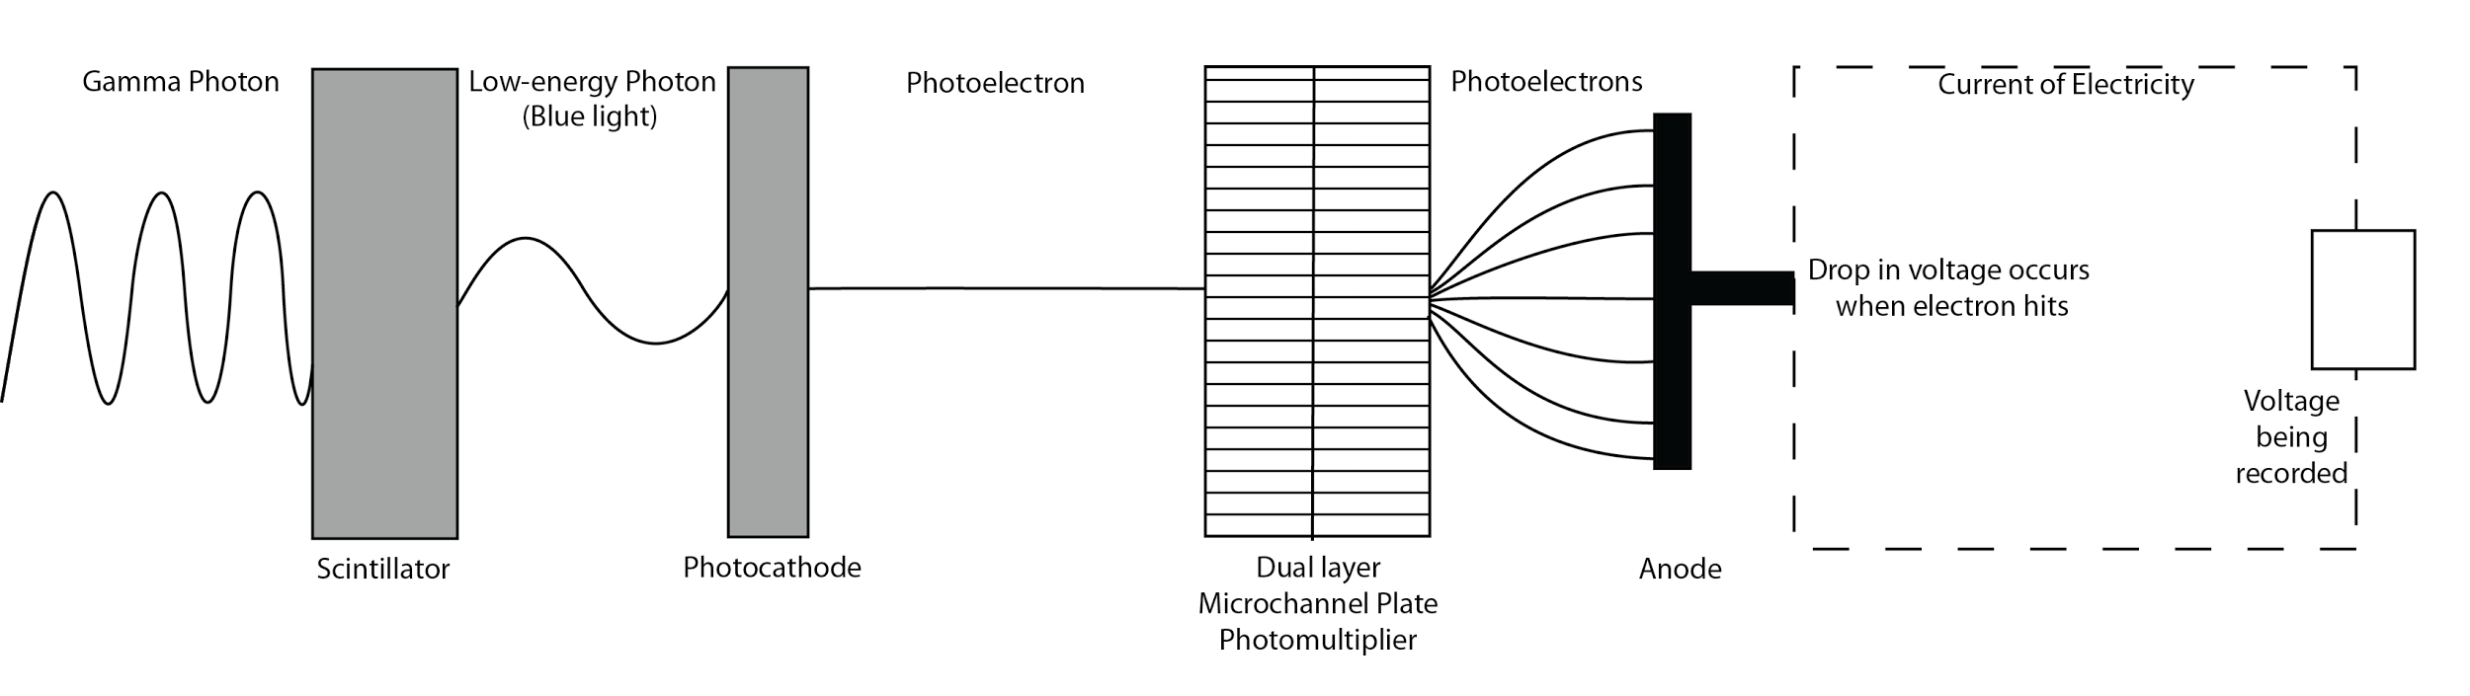
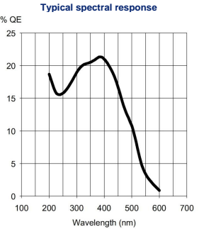
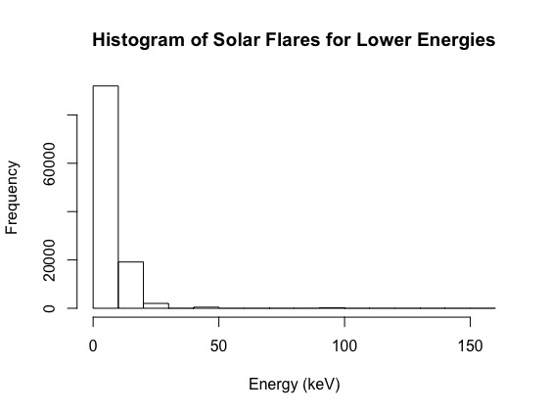
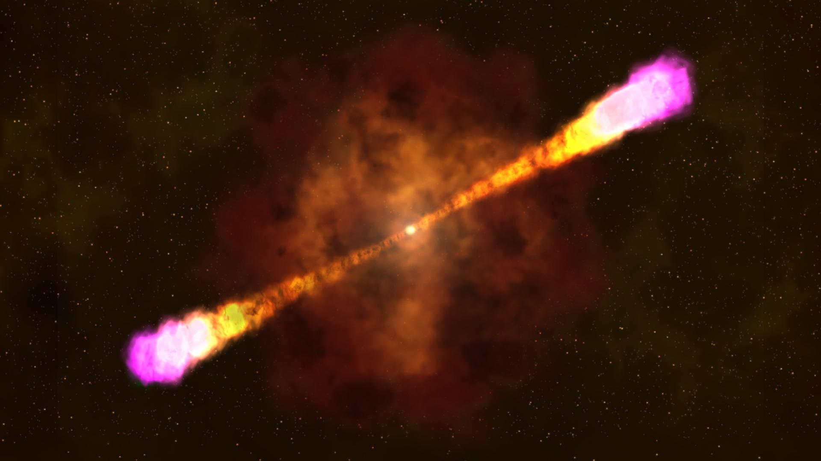
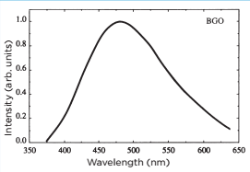
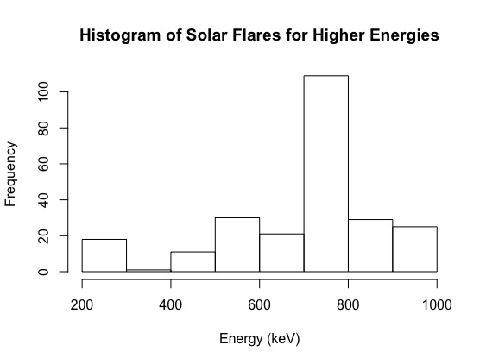
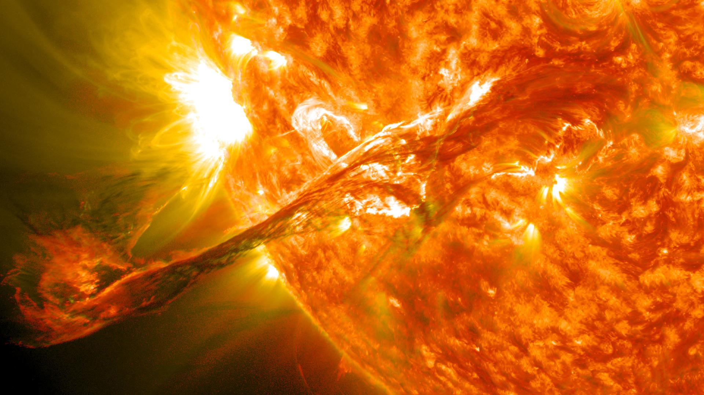



Serenity: Is it possible to assess the sources of gamma radiation in
low Earth orbit using a CubeSat?
Seth Stoudenmier¹, Lucy Williamson², Paige Peck¹, Christopher Johnson³, Stephen Frederico⁴,
Dr. Cassandra Runyon⁵, Dr. Jon Hakkila²
Dept. of Computer Science¹, Dept. of Physics and Astronomy², Dept. of Mathematics³, Dept. of Biology⁴, Dept. of Geology⁵
Introduction
Goals and Objectives
Expected Data
The CubeSat mission Serenity assesses sources of emitted gamma rays in low Earth orbit (LEO), focusing specifically on solar flares and gamma ray bursts (GRBs). The experimental design was inspired by a previous CubeSat mission Firefly, which sought to evaluate aspects of gamma radiation on a terrestrial level. This was achieved by studying terrestrial gamma ray flashes (TGFs), while Serenity proposes to study gamma radiation on an extraterrestrial level. The mission hopes to demonstrate the capabilities of a Cubesat to detect extraterrestrial sources of gamma radiation in LEO.
Serenity contains two scientific goals and five objectives. Through the use of these goals and objectives Serenity aims to answer the following overarching question: Is it possible to assess the sources of gamma radiation in LEO using a CubeSat? These goals and objectives are split into threshold and baseline in the science traceability matrix (STM) shown below. The threshold and baseline goals and objectives are above and below the black lines, respectively, in the STM.
Featured below is a sample of data obtained from the Fermi satellite tracking gamma ray burst counts from 2013. Along the x-axis is the time, in seconds, and the y-axis has the count, divided into three energy ranges. This is an example of what the data we collect may look like.
Featured to the right is a sample of data obtained from the RHESSI satellite tracking solar flares from 2001. The data measures the count rates and energy levels, as well as flux versus energy and produces a reconstructed image of the data based on the gathered readings.
Background
Gamma Radiation
Gamma radiation is the most energetic form of light, with wavelengths so small it can pass through most materials. Despite this, gamma radiation from outer space does not penetrate our atmosphere due to a process called Compton Scattering, which causes gamma radiation to be stopped in the stratosphere (10 to 50km).
Chem.libretexts.org discusses radiation and its effects on matter: “Radiation either ionizes or excites atoms or molecules in living cells, leading to the dissociation of molecules within an organism.” DNA is affected by ionized radiation, and damage to DNA can cause genetic changes that can lead to birth defects and cancer. Gamma rays have a high penetration range which can cause damage to living cells. While Beta particles are used in radiation therapy to kill cancer cells, gamma rays are often used for irradiation, the process of killing living organisms.
Instrumentation
To accomplish the science goals and objectives of this project, the main instrumentation required will be a gamma ray detector. Our gamma ray detector is composed of two main components, a scintillator and a photodetector. We chose the miniPlanacon Photodetector for its small form factor (32x32x24mm) and wide spectral range (200-650nm). The BGO crystal scintillator was chosen to pair with the photodetector because its emissions spectrum (max at 480nm) fits nicely with the spectral range of our photodetector. The BGO crystal will only need a thickness of 4mm to scintillate our focal energy ranges of 200keV. The figures below demonstrate the process of capturing gamma ray flux (left) and the placement of gamma ray detectors in the 1U of the CubeSat that is allocated to our experiment.
Conclusion
For our experiment, we hope to assess the sources of gamma radiation in LEO through measuring gamma ray flux. We expect to see spikes in the flux when known occurrences of GRBs and solar flares are recorded by a secondary source, such as NASA’s FERMI and RHESSI satellites. In these measurements, we also plan to investigate whether it is possible to detect the location of these sources through the use of three gamma ray detectors. The detectors will be placed near each other covering the XYZ axes. This will allow us to rule out fluctuation in data due to cosmic rays and determine the direction of incoming gamma radiation. We do not expect to have difficulty making gamma radiation measurements since it is known that gamma radiation penetrates the atmosphere until the stratosphere, which reaches up to approximately 50km, and our CubeSat plans to be positioned at an altitude of approximately 350 km.
References
National Aeronautics and Space Administration, Science Mission Directorate. 2010. Gamma Rays. http://missionscience.nasa.gov/ems/12_gammarays.html.
National Aeronautics and Space Administration. 2013. Gamma-Ray Detectors. http://imagine.gsfc.nasa.gov/science/toolbox/gamma_detectors2.html.
National Aeronautics and Space Administration. 2013. X-ray/Gamma-ray Astronomy. http://imagine.gsfc.nasa.gov/ask_astro/xrays.html.
National Aeronautics and Space Administration. 2013. Gamma-ray Astronomy. http://imagine.gsfc.nasa.gov/science/toolbox/gamma_ray_astronomy1.html.
National Aeronautics and Space Administration. 2008. NSF / NASA ‘Firefly’ CubeSat Mission to Study Link Between Lightning and Terrestrial Gamma Ray Flashes. https://www.nasa.gov/topics/universe/features/firefly.html.
National Aeronautics and Space Administration. 2016. Firefly: An NSF CubeSat Project. http://firefly.gsfc.nasa.gov/.
National Aeronautics and Space Administration. 2013. Gamma-ray Bursts. http://imagine.gsfc.nasa.gov/science/objects/bursts1.html.
National Aeronautics and Space Administration. 2012. Swift: Catching Gamma-Ray Bursts on the Fly. http://swift.gsfc.nasa.gov/about_swift/#science.
National Aeronautics and Space administration. 2015. SDO Spacecraft & Instruments. https://www.nasa.gov/mission_pages/sdo/spacecraft/index.html.
Wall, M. 2013. Solar Flares Explained: What You Need to Know. Space.com. http://www.space.com/21121-solar-flares-causes-classification.html.
Health Research Funding. Dangers of Gamma Rays. http://healthresearchfunding.org/dangers-gamma-rays/.
Electropaedia. 2005. Electromagnetic Radiation and Radio Waves (Natural and Man-Made Miracles). http://www.mpoweruk.com/radio.htm.
Britannica. 2013. New Views of the Solar System.
University of California, Berkeley. Gamma Rays. http://cse.ssl.berkeley.edu/segwayed/lessons/light/gammaray.html.
Chemistry Libretexts. 2015. National Science Foundation. https://chem.libretexts.org/Core/Physical_and_Theoretical_Chemistry/Nuclear_Chemistry/Radioactivity/The_Effects_of_Radiation_on_Matter
Spectral Response of miniPlanacon Photodetector
Lower energy solar flares collected from RHESSI
Image showing a Gamma Ray Burst (GRB)
Spectral Response of BGO crystal scintillator
Higher energy solar flares collected from RHESSI
The GPS-702-GG-HV Antenna is the engineer’s chosen GPS antenna. Signal reception is unaffected by the rotation of the antenna or satellite elevation. It is enclosed in a durable housing which gives it increased robustness for use under high vibration conditions. The reliability is within typical ranges and can operate at -40°C to 85°C.
Image showing a Solar Flare

